Slide 1

ENGLISH ASSIMENT Topic PERSONAL CARE AND APPEARANCE ____________________ NAME: TRẦN ĐỨC LINH STUDENT ID: PH06402 CLASS: ENT2123.7 TEACHER: HANGTM6

Slide 2
OUTLINE
INTRODUCTION
BODY
History and the development.
The Positive Effects Of Cosmetic Surgery
Enhanced Quality of Life
Increased Energy
Increased Happiness
The Risks of cosmetic surgery
Infection
Poor Cosmetic Outcome
Psychological and Social risk
My opinion
CONCLUSION

Slide 3

I. INTRODUCTION
Hot trend in the society
Getting more and more popular for modern people
Always been the subject of debate and controversy

Slide 4
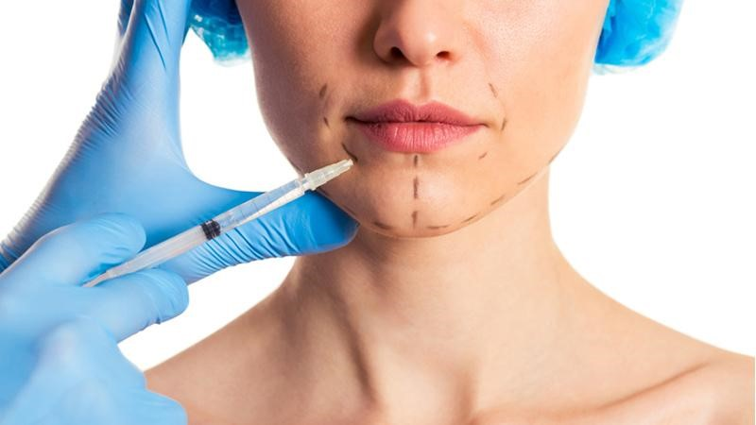
II. BODY
1. History and the development.
Cosmetic surgery procedures have been in existence for centuries
Makes up a magical suction power

Slide 5

II. BODY
2. The Positive Effects
Providing a refreshed vigor and zest.
Enables individuals to become more comfortable and content.

Slide 6
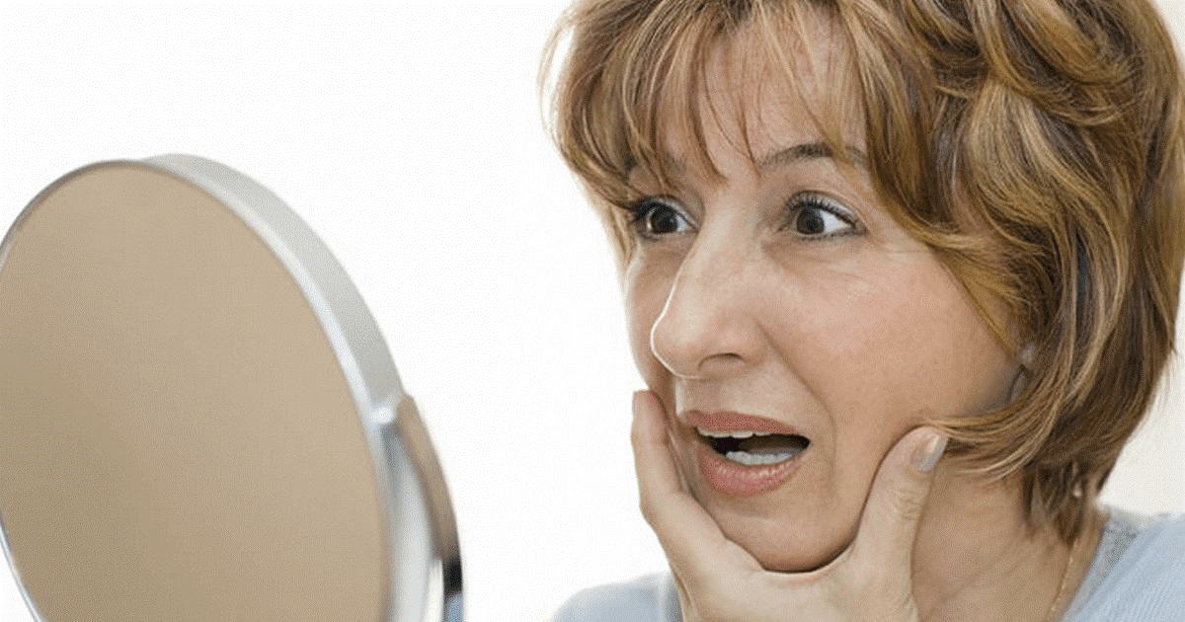
II. BODY
3. The risk
The risk of infection after cosmetic surgery
Makes appearance worse than before the surgery

Slide 7
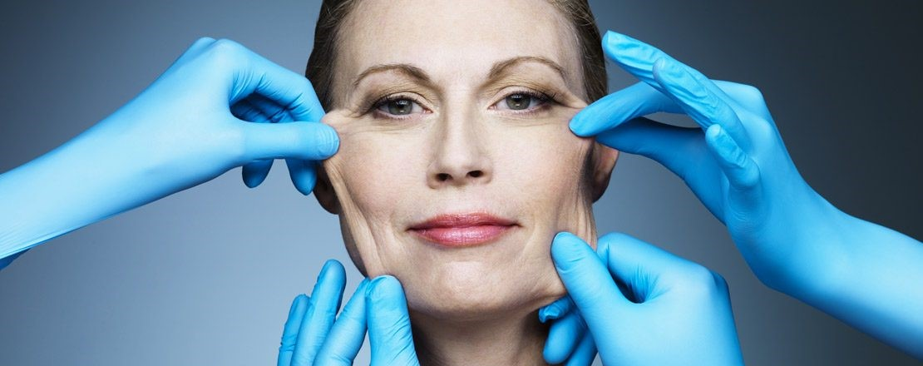
II. BODY
4. My opinion
Some feel it just waste of time, money and the results are also not perfect.
With me, I wouldn't change anything.
For people with non-perfect faces, I don't see the problem with a little alteration.

Slide 8
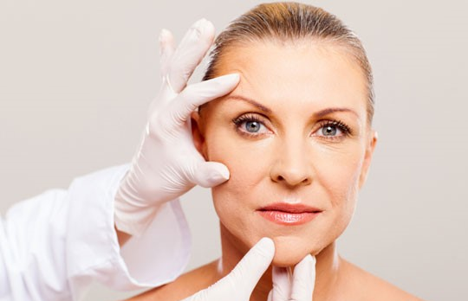
III. CONCLUSION
People undergo cosmetic surgery when they find some defect and needs to improve on body.
It is very important that you do cosmetic surgery for your own self and not for other.

Slide 9
THANKS FOR
WATCHING
AND
LISTENING

